Slide 1
Flood Resilience Strategy Consultation Engagement Session 3 31 July 2024 David Faichney and Billy Pugh

Slide 2
Session Structure
Section | Timings
Welcome and introduction to the Flood Resilience Strategy (FRS) | 1400 -1415
FRS Public consultation | 1415 - 1420
Discussion: Guiding Principles | 1420 - 1435
Discussion: People | 1435 - 1450
Discussion: Places | 1450 - 1505
Discussion: Processes | 1505 - 1520
Wrap up | 1520 - 1530

Slide 3
The National Flood Resilience Strategy
A key part of SNAP3 (formerly known as SCCAP3)
Increasing flood exposure
Our climate is changing
Not delivering actions fast enough
Limited range of actions
Increasing challenge for future generations
Limited range of players
Why?
Flooding is our biggest domestic climate adaptation challenge

Slide 4
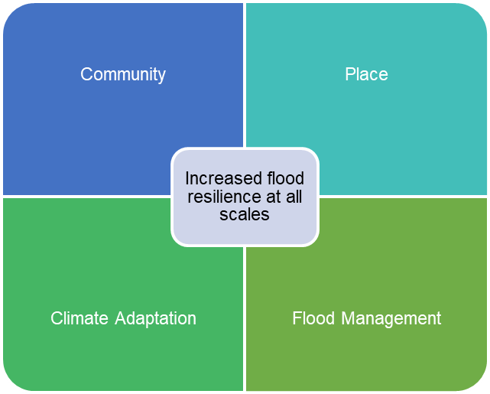
A Stronger & More Resilient Scotland - The Programme for Government 2022 - 23
Consult on a new flooding strategy for Scotland, including how we can build community flood resilience and engage a broader range of delivery partners to deliver more diverse flood management actions faster.
Thinking to 2045 and beyond…
What needs to change…
Direction setting
Notes:
The commitment

Slide 5
What is the purpose of the Flood Resilience Strategy?
To change our approach from “fixing flooding problems” to creating flood resilient places
To lay-out the principles we must follow to improve flood resilience in the period ahead
To set out the strategic level changes that we need to make
Make the best use of all available resources
…reducing flood exposure by all available means

Slide 6
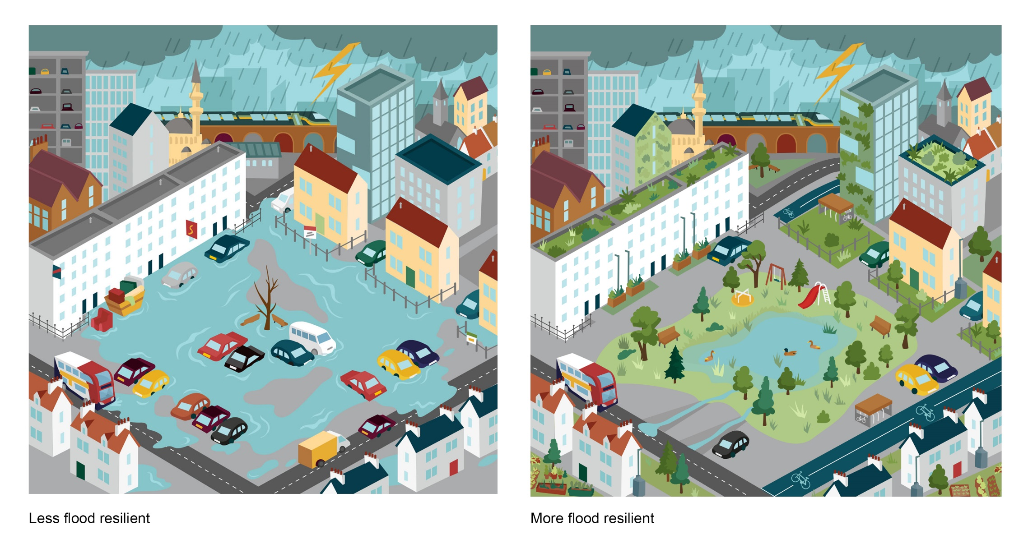
What does flood resilience look like?

Slide 8
Guiding principles
We will change the focus from ‘fixing flooding problems’ to creating flood resilient places.
Flood resilience is part of community resilience and part of adapting to climate change, so everyone has a role to play.
At the heart of our flood resilience activities will lie the principles of a Just Transition. (to secure a fairer, greener future for all by working in partnership to deliver fairness and tackle inequality and injustice).
Everyone benefits from flood resilient places, and we all have a contribution to make.

Slide 9
Guiding principles discussion – 15 minutes
Do you agree with the transition from “fixing flooding problems” to creating flood resilient places?
Do you agree with the proposed guiding principles? Are there any changes you would suggest?
How do we ensure that our work to build flood resilience is fair and aligns with the principles of a Just Transition?
What is a just transition?
A just transition is both the outcome – a fairer, greener future for all – and the process that must be undertaken in partnership with those impacted by the transition to net zero. Just transition is how we get to net zero and a climate resilient society and economy, in a way that delivers fairness and tackles inequality and injustice.

Slide 10
Consultation document structure
People and places are prepared for increased flooding
-We are adapting to a changing climate, creating sustainable resilient places in ways that are inclusive and fair
People -
Creating flood resilient places involves our people and communities.
Places -
Land management and placemaking decisions follow good practise for flood resilience.
Processes -
Flood resilience is blended into our places at all scales. A broader range of actions are being delivered by a broader range of delivery partners.

Slide 11
Involving people more
Developing community flood resilience as part of climate adaptation
Involving people in the design of their places
Helping them understand their flood exposure and how that may change through time
Helping them understand the options they may have
Short-term
Long-term
Small–scale
Large-scale
How can our people contribute to our flood resilience?
...education too - from early school years on.

Slide 12
People discussion – 15 minutes
How can all relevant authorities work better with communities to make decisions about their places in future?
What one thing would be most useful in ensuring communities are empowered to meaningfully contribute to decisions about their places?
What role can education play in the building of flood resilience in Scotland?

Slide 13
Making the most of our places
Placemaking
Making space for water
Making better use of land – urban and rural
Bringing those involved in place-based design and adaptation projects together
Optimising drainage networks -
natural and man-made
Long-term thinking
Slow transition away from the most exposed areas
How can our places contribute to our flood resilience?
Notes:
The most relevant theme for this group

Slide 14
Places discussion – 15 minutes
How can we ensure that our places are designed to be flood resilient in future?
How best can we make space for water in our towns and cities?
Should relocation be considered as an option in areas with the highest flood exposure?

Slide 15
Improving processes to support the change
How can our processes contribute to our flood resilience?
Increasing the range of actions
Increasing range of delivery partners
Using flood risk management plans to bring forward different actions
Accessing and deploying available resources
Supporting delivery partners
Improving governance, delivery and funding mechanisms

Slide 16
Processes discussion – 15 minutes
How can we improve the efficiency and diversity of flood management actions?
Other than large flood protection schemes, what kinds of flood resilience- building activities should be prioritised?
What support is required to enable change?
What is your biggest concern about flooding?
What one thing would you do to improve Scotland’s flood resilience?

Slide 17
Consultation details
Open until Tuesday 13 August
Flood Resilience Strategy: consultation - Scottish Government consultations - Citizen Space
Flood resilience strategy: consultation - gov.scot (www.gov.scot)

